Slide 1

Online Quiz Management System
Case Study Presentation Using SQL
By
Prachi Balasaheb More

Slide 2
Introduction
An Online Quiz Management System is designed to demonstrate how quiz-related data can be structured, stored, and retrieved using relational database concepts. In this project, multiple tables such as Users, Quizzes, Questions, Options, UserAnswers and Scores are created to represent different entities of a quiz system. Relationships between these tables are established using primary and foreign keys to maintain data integrity. Various SQL queries are performed to retrieve meaningful information, such as fetching quiz details, analyzing user performance, calculating scores, and generating reports using operations like JOIN, GROUP BY, HAVING, and subqueries. The project focuses on efficient data organization and query execution rather than building a user interface, highlighting the practical use of SQL in managing and analyzing structured data.

Slide 3
Tools Used :
1)SQL → For creating tables and writing queries
2)MySQL → Database system used to store and manage data
3)MySQL Workbench → For designing schema and executing queries
4)DBMS → Concepts like normalization, keys, relationships
Focus Areas :
The main focus of this project was on designing a proper database structure and writing effective SQL queries. I worked on creating different tables such as Users, Quizzes, Questions, Options, UserAnswers and Scores, and linking them correctly using keys. Another important part was writing queries to retrieve useful information like calculating scores, finding average performance, and joining multiple tables. Overall, the project helped me understand how data is organized and how SQL can be used to analyze it efficiently.

Slide 4
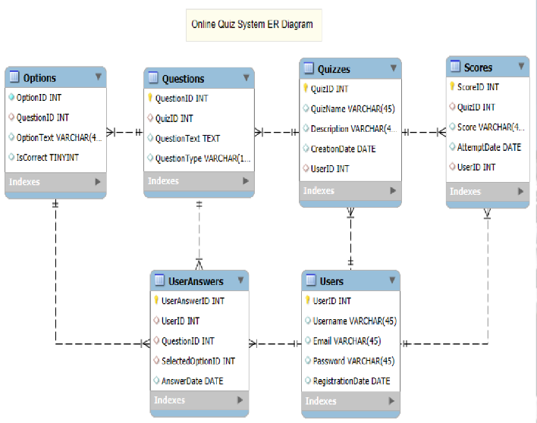

Slide 5
Basic SQL Analysis
I worked with simple SQL queries to retrieve and manage data from the tables. This included using commands like SELECT, INSERT, UPDATE, and DELETE. I also used conditions with the WHERE clause to filter specific records, such as finding quizzes created after a certain date or questions of a particular type. These queries helped in understanding how to access and manipulate data in a structured way.
Intermediate SQL Analysis
I used more advanced queries to combine and organize data from multiple tables. This included using JOIN operations (INNER JOIN, LEFT JOIN) to connect related tables like Users, Quizzes, and Scores. I also used GROUP BY and HAVING clauses to perform aggregations, such as counting the number of questions per quiz or finding users who attempted multiple quizzes. These queries helped in analyzing relationships and summarizing data.
Advanced SQL Analysis
I worked with complex queries involving subqueries and nested queries. I also practiced combining multiple SQL concepts like JOINs with subqueries to retrieve more detailed insights. This level helped me understand how to handle complex data analysis using SQL efficiently.

Slide 6
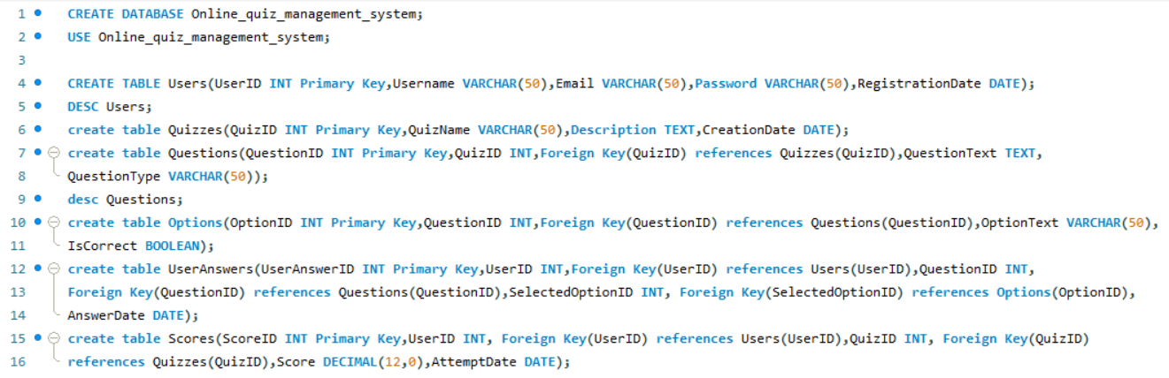
MySQL Screenshots
Create all the tables with the specified columns and foreign key references.

Slide 7
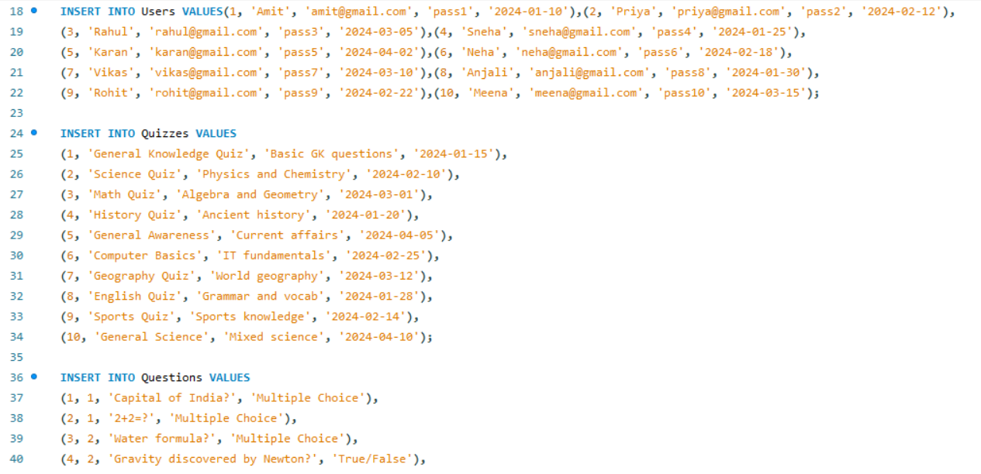
Insert at least 10 records into each of the tables to populate the database with sample data.

Slide 8
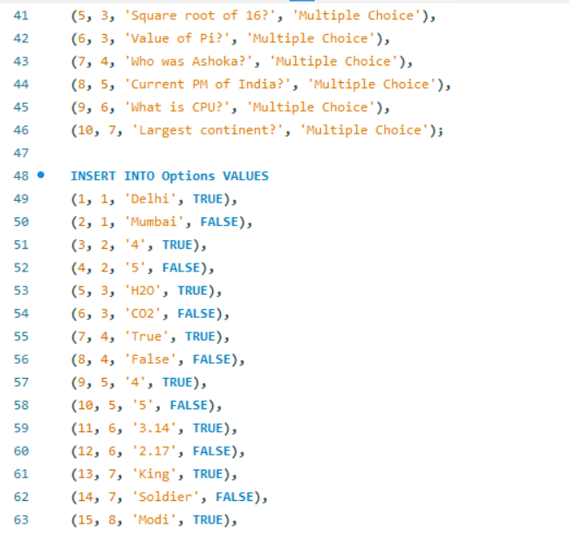
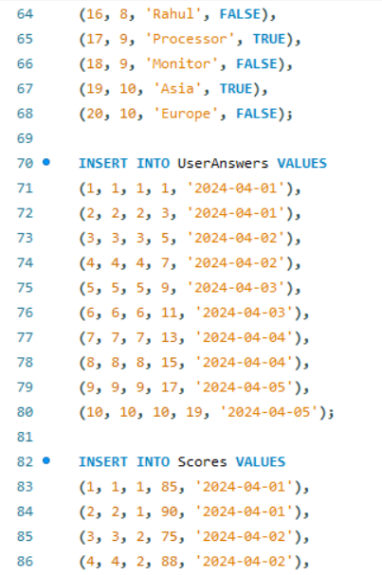
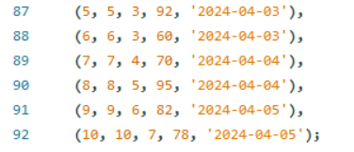

Slide 9

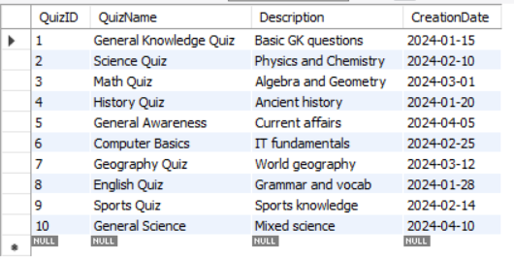
Select all quizzes created after January 1, 2024, from the Quizzes table.
Output :

Slide 10
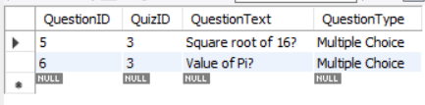
Select all questions where the QuestionType is 'Multiple Choice' and the QuizID is 3.
Output :

Slide 11
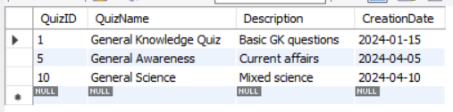
Select all quizzes where the QuizName contains 'General'.
Output :

Slide 12
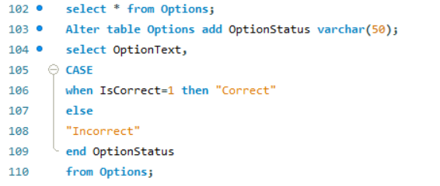
Select OptionText and a new column OptionStatus from the Options table. If IsCorrect is TRUE, set OptionStatus to 'Correct', otherwise 'Incorrect'.

Slide 13
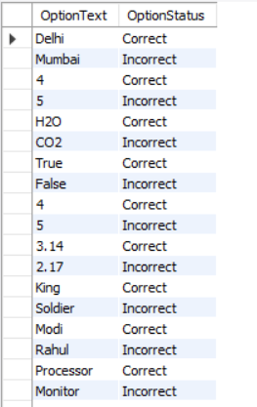
Output :

Slide 14

Find all users who have answered more than 20 questions.
Output :

Slide 15
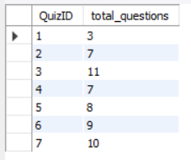
Total number of questions for each quiz.
Output :

Slide 16

Total number of quizzes created by each user, but only include users who have created more than 3 quizzes.
Output :

Slide 17
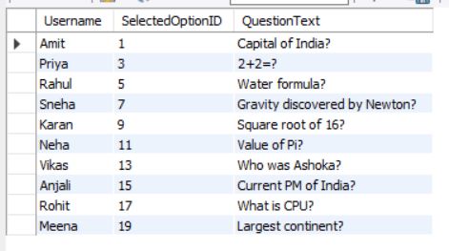
List of all user answers including Username, QuestionText, and SelectedOptionID.
Output :

Slide 18
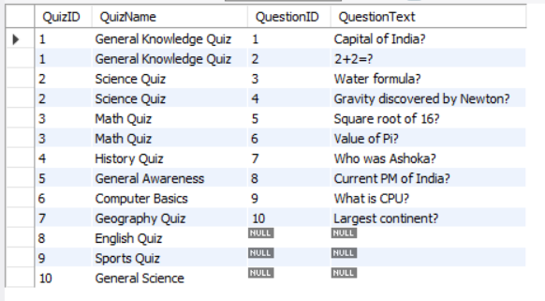
List of all quizzes and any associated questions, include quizzes that might not have any questions.
Output :

Slide 19

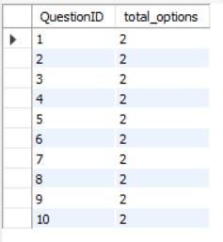
Total number of options for each question.
Output :

Slide 20

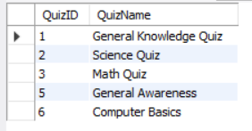
Find all quizzes where the average score for all users is higher than 80.
Output :

Slide 21

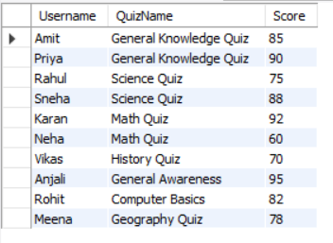
List Username, QuizName, and Score for all users who have completed a quiz.
Output :

Slide 22
Insights :
SQL queries helped in retrieving and organizing quiz data efficiently, making it easier to generate useful information from multiple tables.
Using JOINs made it possible to combine data from different tables and get meaningful insights like user responses and results.
Proper table design with keys and relationships ensured accurate data retrieval and made the system easy to manage and scale.

Slide 23
Thank You !

